Slide 1
Type Code - Refactoring

Slide 2
Agenda
Theory
Refactoring
Code Smells
Type Code Refactoring Approach
Code Examples
Refactoring technique with Class
Refactoring technique with Sub-Classes
Refactoring technique with Patterns (next lecture)

Slide 3
The Definition of Refactoring
“Code refactoring is the process of restructuring existing computer code without changing its external behavior. “ – Martin Fowler

Slide 4
Code Smells

Slide 5
What are code smells?
Answer: Poor code-base quality indicators

Slide 6
Cure for smells?
Answer: Refactoring

Slide 7
Example of Code Smells
Code Duplication
Large Class
Long Parameter List
Long Method
Inappropriate Intimacy
Primitive Obsession

Slide 8
Primitive Obsession
Structural approach
Using primitives (int, etc.) instead of objects (classes)

Slide 9
Type Code Examples

Slide 10
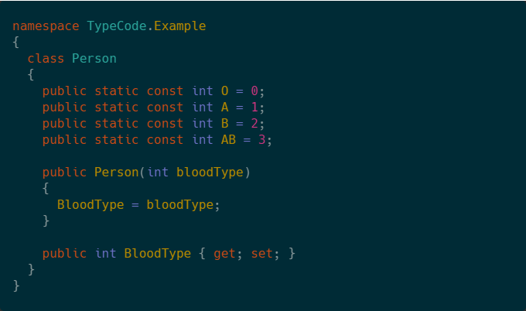

Slide 11
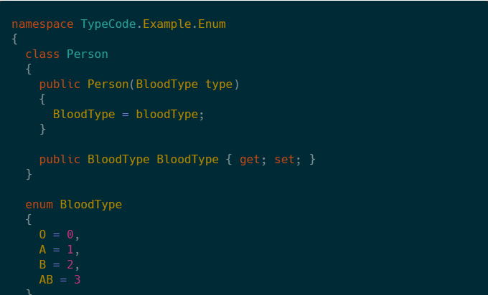

Slide 12
Refactoring Techniques for Type Code
Replace Type Code with Class
Replace Type Code with Sub-Classes
Replace Type Code with State or Strategy Pattern

Slide 13

Replace Type Code with Class
Prerequisites:
Type Code is not used in computing
Want to use Enum or simple Class

Slide 14

Replace Type Code with Sub-Classes
Prerequisites:
Behaviour depends on a type
Class’s data structure depends on a type
A type don’t change at runtime

Slide 15

Replace Type Code with State or Strategy Pattern
Prerequisites:
Behaviour depends on a type
Can’t use Sub-Classes
A type change at runtime

